Slide 1
Processor Basics

Slide 2
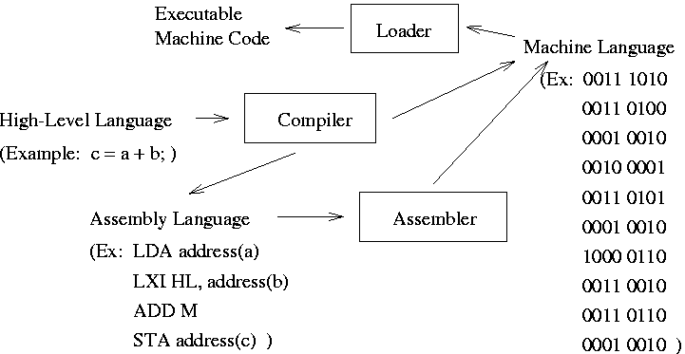
Computer Program Execution

Slide 3
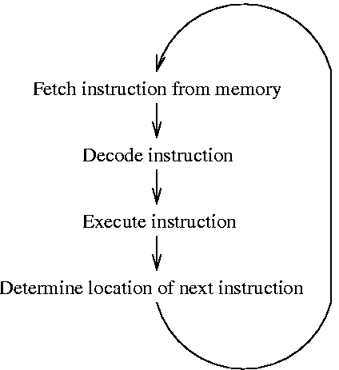
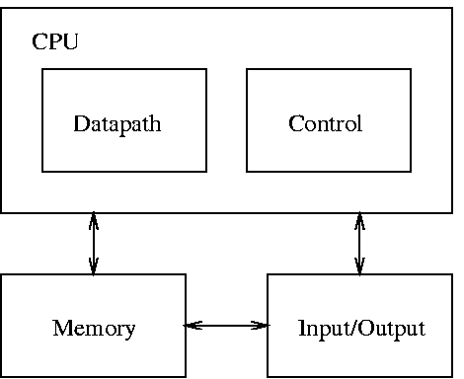
Block Diagram and Basic Operation
Block Diagram
Basic Operation
(Program Control Unit)
(Data Processing Unit)
ISR
Check for Interrupts

Slide 4
Basic CPU Design
Most instructions are of form: X1 = f(X2, X3)
  Close correspondence with the register-transfer operations performed in the datapath
Simple CPU designs typically use “Accumulator”
  Accumulator (AC) is the “default” register used as the destination register (X1 above) and the first source register (X2 above)
  Other typical “default” registers:
    IR (instruction reg.), PC (program counter), MAR (or AR, memory address register), MDR (or DR, memory data register)

Slide 5
Example CPU Design Problem
Design a CPU with only 3 types of instructions:
  MOV r1, r2 // move contents of register r2 to register r1
  ADD r // add contents of register r with accumulator
  ANA r // “and” contents of register r with accumulator
Ignore interrupt handling for now
Design Approach
  Use the 5-step ASM design method
  First, devise a pseudocode solution for the operation of the CPU

Slide 6
Pseudocode solution:
  1. AR <-- PC
  2. Increment PC by 1
  3. Fetch M[AR] into instruction register IR
  4. Switch (IR) begin
  case “MOV r1, r2”: r1 <-- r2 ;
  case “ADD r”: AC <-- AC + r ;
  case “ANA r”: AC <-- AC “and” r ;
  end;
  5. Repeat from Step 1
Question: how could interrupts be handled?

Slide 7
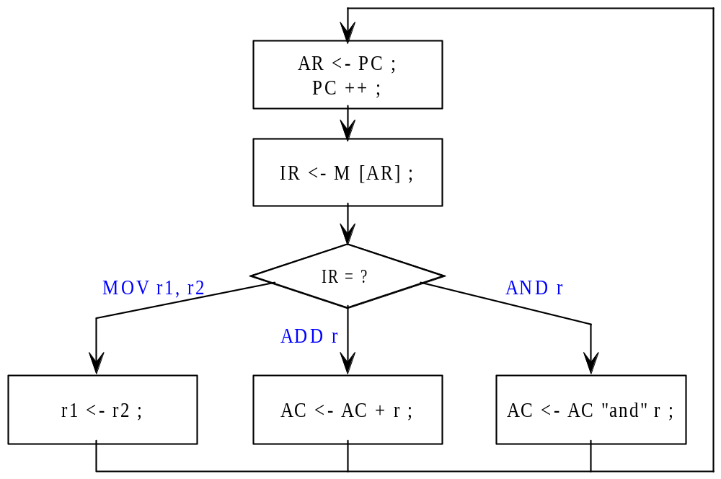
ASM Chart:
If (r = AC) AC <- AC + AC;
If (r = B) AC <- AC + B;
If (r = C) AC <- AC + C;
...
Datapath:
Shown in Fig. 3.3 of [Hayes 1998].

Slide 8
Expanded Instruction Sets
Add more types of instructions
  data transfer (load, store, move),
  data processing (add, subtract, …),
  and program control (branch, conditional branch)
Refer to Fig. 3.4: Expanded instruction set
Fig. 3.5.: A program to implement
  AC := AC x N
  “mult” is the memory address containing the data “N”
Fig. 3.6.: Execution trace for multiplication prog.

Slide 9
Instruction Set Design
Fixed versus Variable-Length Instruction Formats
  Fixed-length instruction format
    use same number of bits to represent all instructions
    leads to simpler (and faster) instruction decoding
    facilitates fast and effective prefetching of instructions
  Variable-length instruction format
    use different numbers of bits for different instructions
    can accommodate short and long instructions (requiring extra bits to represent data operands) without a waste of memory
    prefetching and decoding of instructions is more difficult

Slide 10
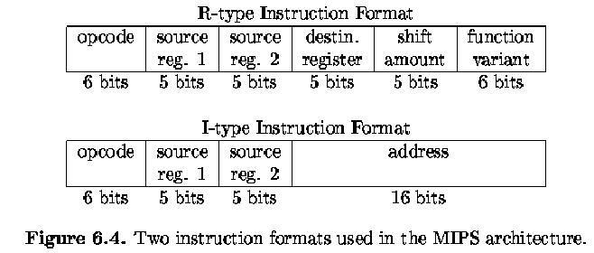
Example of fixed-length instruction formats used in the MIPS (Millions of Instruction Per Second) microprocessor
[Lee 2000]

Slide 11
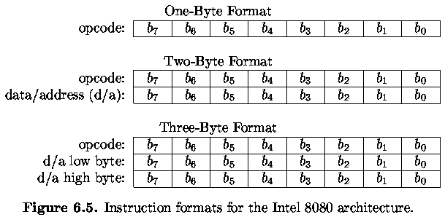
Variable-length instruction formats used in the Intel 8080 architecture
[Lee 2000]

Slide 12
Number of Data Operands
Zero-operand instructions
  data is accessed from the “stack” (a LIFO (last-in-first-out) queue)
One-operand instructions
  the accumulator (ACC) register is used as the default second data input and destination
Two-operand instructions
  one of the data inputs is the default destination
Three-operand instructions

Slide 13
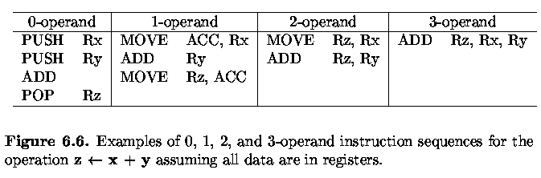

Slide 14
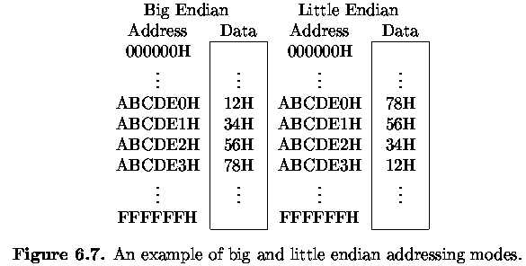
Endian Mode
Example Instruction: Store 12345678H, ABCDE0H
[Lee 2000]

Slide 15
Addressing Modes
Location of Data
register (or register-direct) addressing: R1
register indirect addressing: M[R1]
immediate addressing: data
direct (or absolute) addressing: M[address]
indirect addressing: M[M[address]]
implicit addressing: default location
relative & indexed addressing: M[R1+address]
pre-decrement, post-decrement, pre-increment, ...

Slide 16
Other Instruction Design Issues
I/O Address Mapping
  I/O-mapped I/O (or direct-mapped I/O)
    special I/O instruction accesses I/O port
  memory-mapped I/O
    memory instruction accesses I/O port
Interrupt Handling
  internal and external interrupts
  generated by system or user software, hardware
  check for interrupts once every instruction cycle

Slide 17
Modern CPUs
Employ a variety of speedup techniques
  cache memories
  special purpose instructions (e.g., test-and-set, MMX)
  redundant hardware modules -> superscalar, VLIW, ...
  support for parallel processing
  pipelining
Simple 2-stage instruction pipeline --> p. 149
  Overlap PCU and DPU actions whenever possible
  Refer to Fig. 3.8 (p. 150)
  If a “branch” occurs, the pipeline must be “flushed”

Slide 18
ARM6 Microprocessor (Figs. 3.9, 3.10)
  modern 32-bit RISC microprocessor
  has a “file” of 32-bit general-purpose registers
  in “user” mode, 16 32-bit registers (R0, …, R15) visible
  has a load-store architecture (only LOAD and STORE instructions can access memory; all others use registers)
  uses an instruction pipeline
Motorolla 68020 (Figs. 3.11, 3.12)
  slightly old 32-bit CISC microprocessor
  has register file of 32-bit registers (8 data, 8 address)
  large number of instructions, addressing modes
  uses memory-mapped I/O
  does NOT use a load-store architecture

Slide 19
There are two advanced features and commercial
microprocessor:
Reduced Instruction Set Computer (RISC) and
Complex Instruction Set Computer (CISC)
There are many way in which basic design of CPU can be
improved. Most recent CPUs contain the following
extensions which improve their performance and case of
Programming.
        Multipurpose register set for storing data and address
        Additional data, instruction and address type
        Register to indicate computation status
        Program control stack

Slide 20
Pipeline:
Modern CPUs have a variety of speedup techniques,
including cache memories, and several forms of
instruction level parallelism. Such parallelism may be
present in the internal organization of DPU or in the
overlapping of the operations carried out by the DPU and
PCU. These features add to the CPU’s complexity.

Slide 21
Overlapping of instruction fetching and execution is an example of
instruction pipelining which is an important speedup feature of
RISC processor. Each instruction can be thought of as passing
through two consecutive stages of processing: a fetch stage
implemented mainly by PCU and an execution stage implemented
mainly by DPU. Hence two instruction can be processed
simultaneously in every CPU clock cycle, with one completing its
fetch phase and other completing its execute phase. This
Simultaneous process is called two stage instruction pipeline.
[Fig 3.8]

Slide 22
I₁
Fetch
Execute
I₂
Fetch
Execute
I₃
Fetch
Execute
1
2
3
4
Fig 3.8: Overlapping instruction in a two stage instruction pipeline

Slide 23
The two principal number formats are fixed-point
and floating-point. Fixed-point formats allow a
limited range of values and have relatively simple
hardware requirements.
Floating-point numbers, on the other hand, allow a
much larger range of values but require either costly
processing hardware or lengthy software
implementations.

Slide 24
Fixed Point number:
  The number types to be represented; for example
  integers or real number.
  The range of values (number magnitudes) likely to be
  encountered.
  The precision of the numbers, which refers to the
  maximum accuracy of the representation.
  The cost of the hardware required to store and process
  the numbers.

